Slide 1
Atmosphere Virtual Lab (AVL) for EarthCARE
Sander Niemeijer, S[&]T
26 June 2023

Slide 2
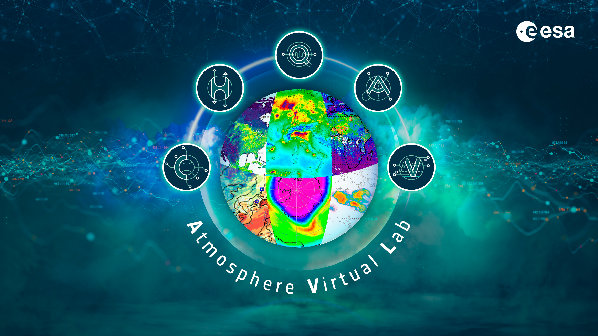

Slide 3

Atmosphere Virtual Lab
Continuation of Atmospheric Toolbox software
Refocus on using atmospheric data in a cloud environment
https://atmospherictoolbox.org

Slide 4
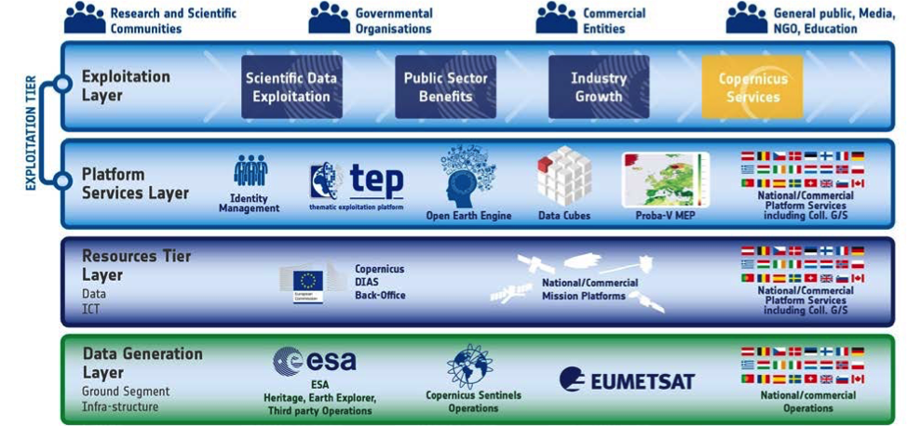
Atmosphere Virtual Lab
New challenges within Exploitation Tier

Slide 5
Atmosphere Virtual Lab
Old approach (Toolboxes):
  Desktop application
  local 👍, cloud 👎
  Fast plotting (GPU) 👍
  Require data locally 👎
  Locked-in environment 👎
New approach (Virtual Labs):
  Web application
  local 🤞, cloud 👍
  Fast plotting (GPU) 👍/🤞
  Direct access to data in cloud 🤞
  Open ecosystem 🤞

Slide 6
Atmosphere Virtual Lab
Focus in AVL project is on bringing the tools to cloud platforms
(e.g. DIAS/DataspaceService, Exploitation Platforms, MAAP)
  Most cloud platforms focus on Python and Notebooks for interactive analysis
Solution based on JupyterLab
  Use what is already there (numpy, matplotlib, cartopy, plotly, leaftlet, etc.)
  Improve/extend python interfaces for CODA/HARP/QDOAS
  Improve interactive geographical plots for atmospheric data
  (replace VISAN as main visualisation environment)
Project result is software that can be deployed in exploitation platforms;
AVL is not a cloud service itself
Also allow running AVL standalone on local computers

Slide 7
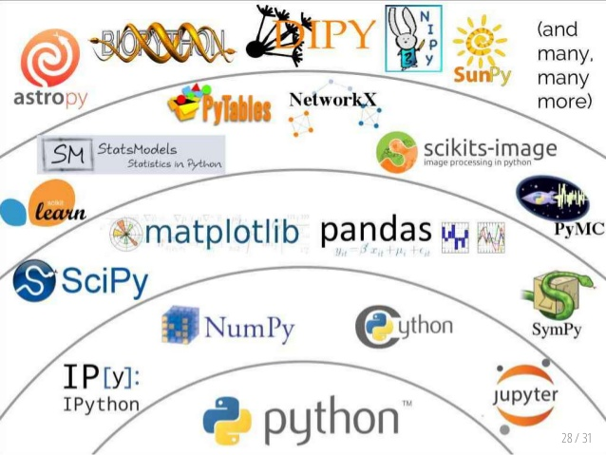
Atmosphere Virtual Lab
Become part of the scientific python ecosystem
  CODA – file reading library/tools supporting large variety of data formats
  HARP – library/tools for easy ingestion, data comparison, regridding, etc.
  QDOAS – DOAS retrieval application
  VISAN – desktop application for visualisation

Slide 8
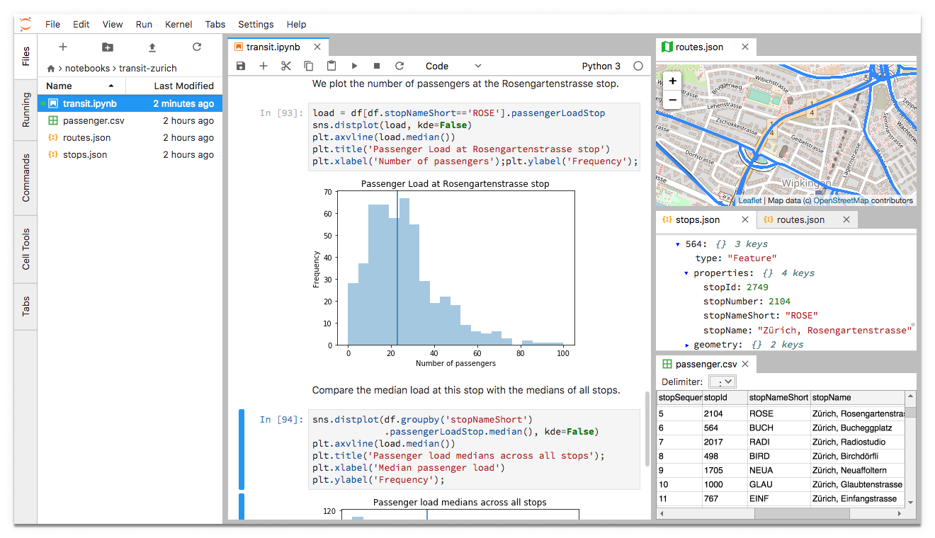
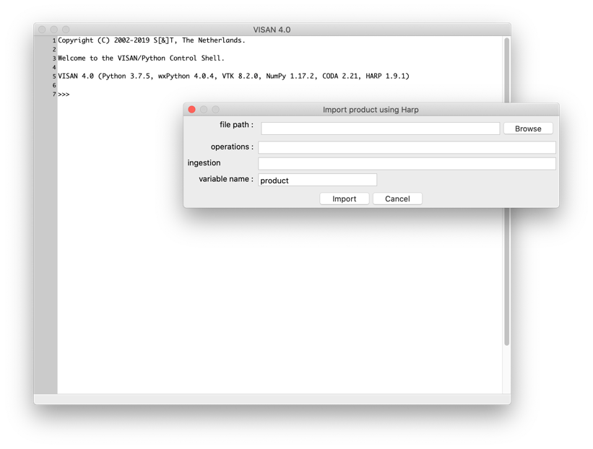
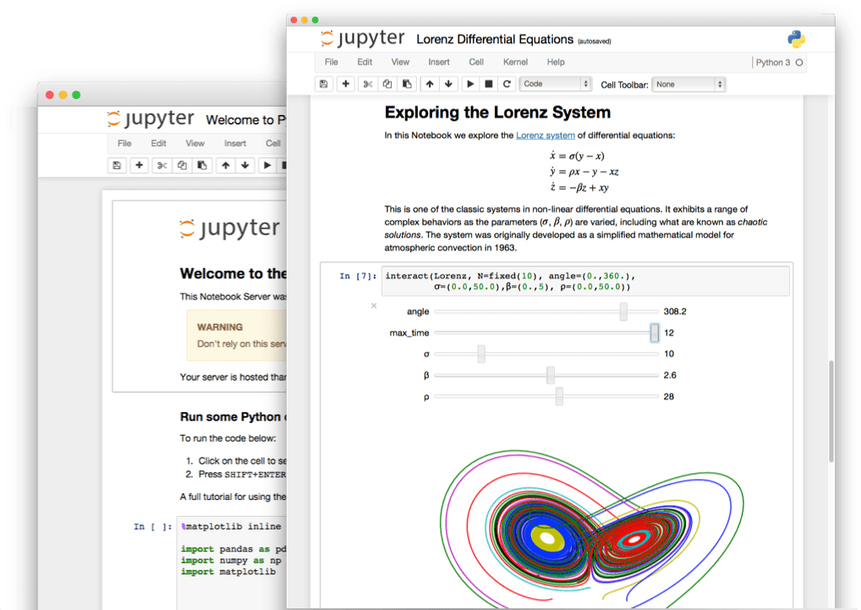
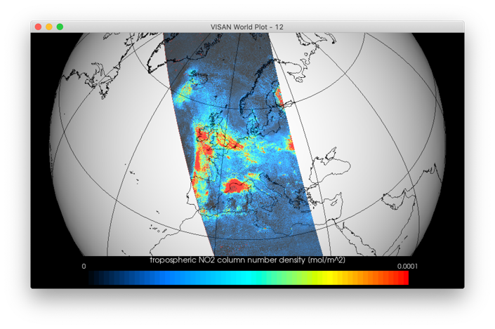
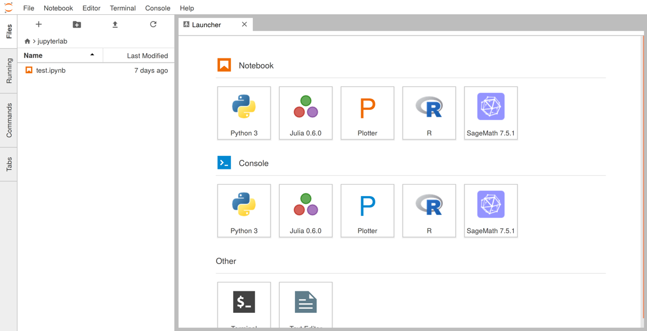
Atmosphere Virtual Lab

Slide 9
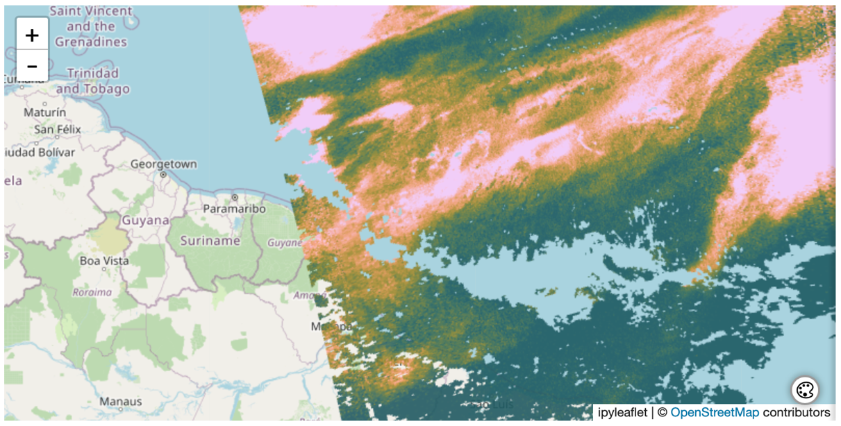
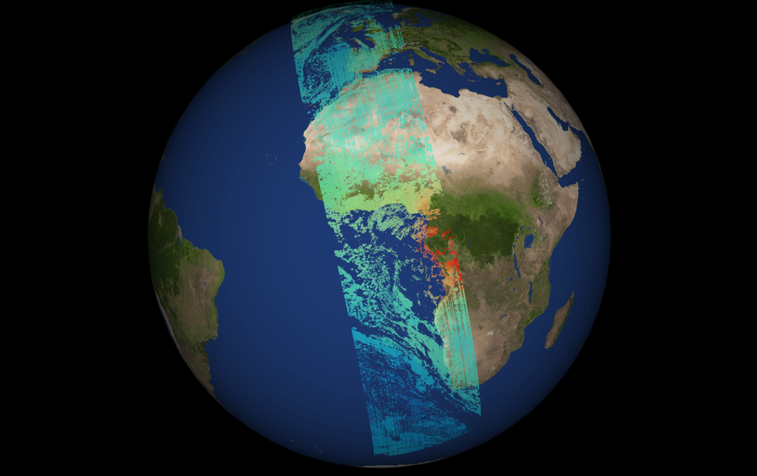
Atmosphere Virtual Lab
What we have developed (available since about 1 year):
New visualisation modules/packages
  Single command to create jupyterlab plot of HARP data
  Fast (GPU) and accurate visualisation of L2 swaths
  (using actual corner coordinates) and L3 maps

Slide 10

Atmosphere Virtual Lab
Everything available via conda-forge
$ conda create -n avl
$ conda activate avl
$ conda install -c conda-forge atmosphere-virtual-lab
$ jupyter-lab
https://atmospherevirtuallab.org

Slide 11
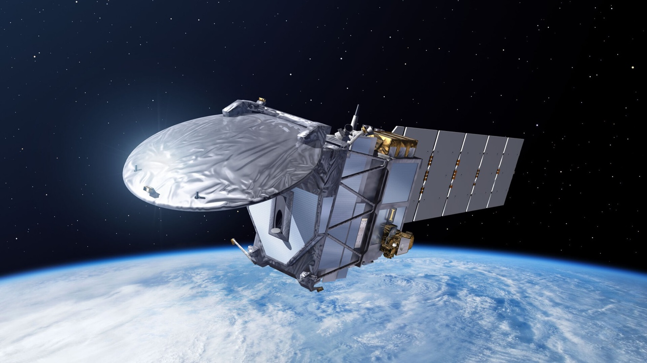
Atmosphere Virtual Lab
Support for EarthCARE
  HARP support for main products
  HARP support for reference data (e.g. EVDC, GEOMS, cloudnet, …) and similar missions (CALIPSO)
  Support validation with inter-comparison functionality of HARP

Slide 12
Atmosphere Virtual Lab
Most important component for validation community is HARP
harpconvert
harpdump
harpcollocate
other...
R interface
Python interface
Matlab interface
IDL interface
harpmerge
harpcheck
other...
other...
HARP C library
Ingestion modules:
Sentinel 5P, OMI/TES/MLS/HIRDLS, GOME-2/IASI, GOMOS/MIPAS/SCIAMACHY, GOSAT, Odin/OSIRIS, Atmospheric CCI, AEOLUS, EarthCARE, CAMS, NDACC, ...
Unit
conversion
Derived
variables
Collocation
Filtering
Regridding
Import/
Export
CODA C library
HDF4 library
HDF5 library

Slide 13
Atmosphere Virtual Lab
HARP is not just software, but also a set of conventions:
  simple data structure like netcdf (product with variables; no grouping)
  global attributes, variable attributes
  similar/complementary to e.g. netCDF-CF, but not fully compatible (CF couples dimensions to coordinate variables; HARP keeps these fully separate)
  variable naming convention
    similar things should be named similarly
    different things should be named differently
    measurements from different instruments or different retrieval algorithms belong in different files (allows use of same variable name)
http://stcorp.github.io/harp/doc/html/conventions/index.html

Slide 14
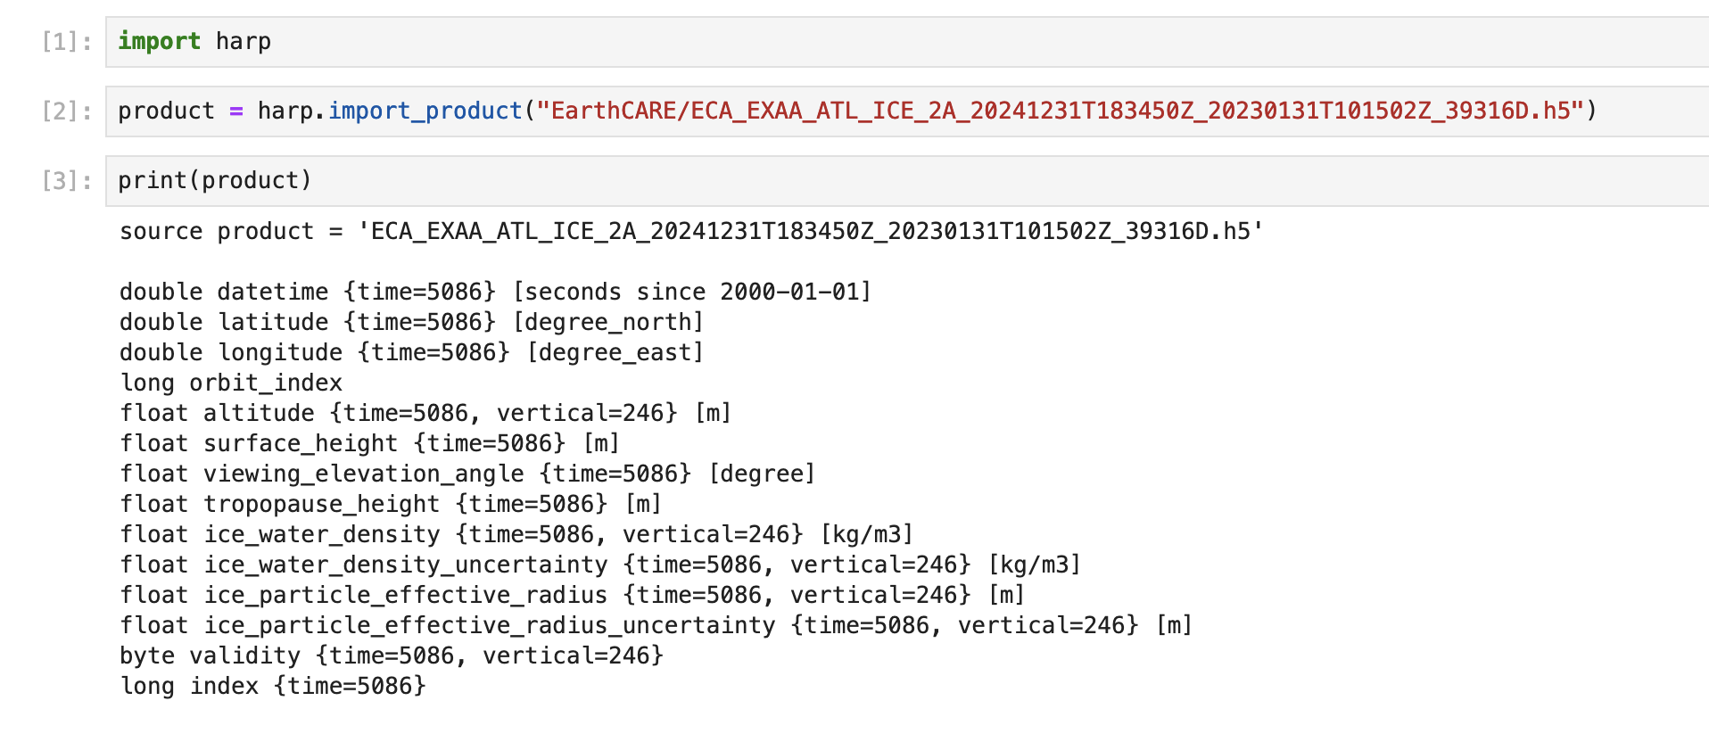
Atmosphere Virtual Lab

Slide 15
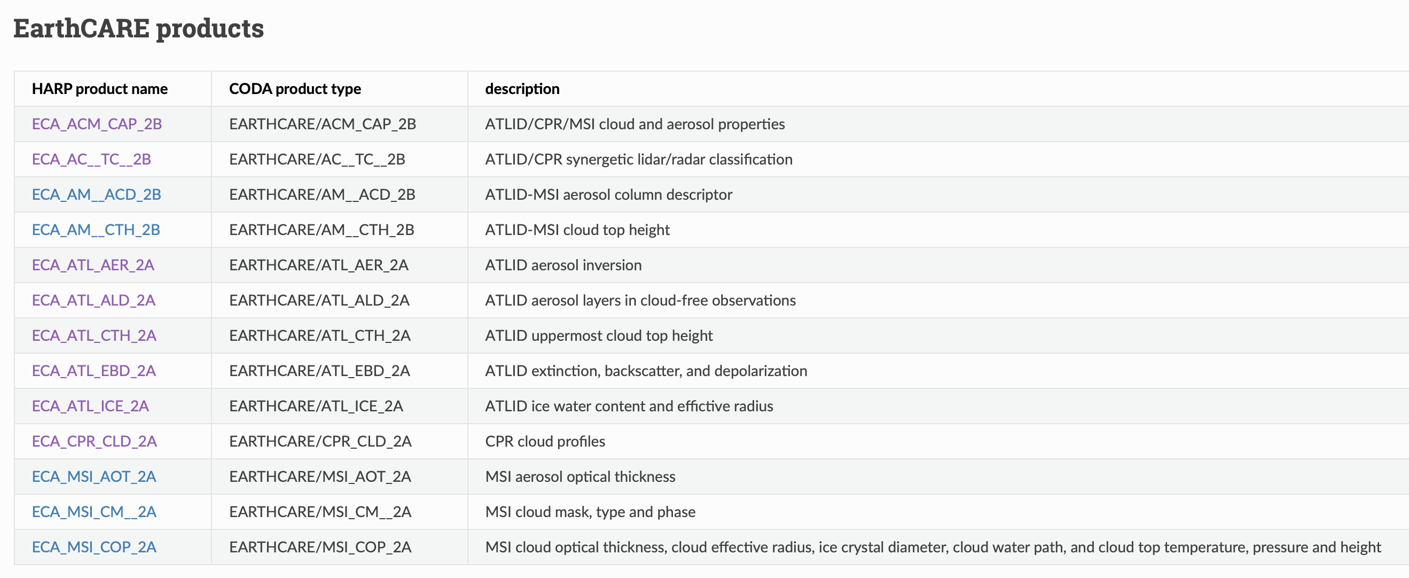
Atmosphere Virtual Lab

Slide 16
Atmosphere Virtual Lab
EarthCARE specific considerations:
ice_water_content and ice_water_path vs
ice_water_density and ice_water_column_density
consistency with other quantities:
H2O_density, H2O_column_density
H2O is sum of water components (water_vapor, rain_water, liquid_water, …)
HARP has built in algorithm to create x_column_density from x_density
similar: aerosol_mass_content vs aerosol_density
distinction between 'molecules’ and 'particles’:
liquid_water_number_density (number of molecules) vs liquid_particle_number_density (number of droplets)
So 'liquid_effictive_radius' -> 'liquid_particle_effective_radius'

Slide 17
Atmosphere Virtual Lab
EarthCARE specific considerations:
Heights in EarthCARE are with regard to reference ellipsoid
but altitudes are with regard to MSS/Geoid
Every other product either uses Geoid as reference (=altitudes) or provides a conversion factor (geoid height wrt reference ellipsoid): Aeolus, Cloudsat, Calipso, Earlinet, Cloudnet, GEOMS
This will become a validition problem!
ESA mentioned that product formats will be updated to use Geoid as reference height.
Current HARP implementation maps height wrt reference ellipsoid to altitude as temporary solution. This will be fixed once product formats get updated.

Slide 18
Atmosphere Virtual Lab
DEMO

Slide 19
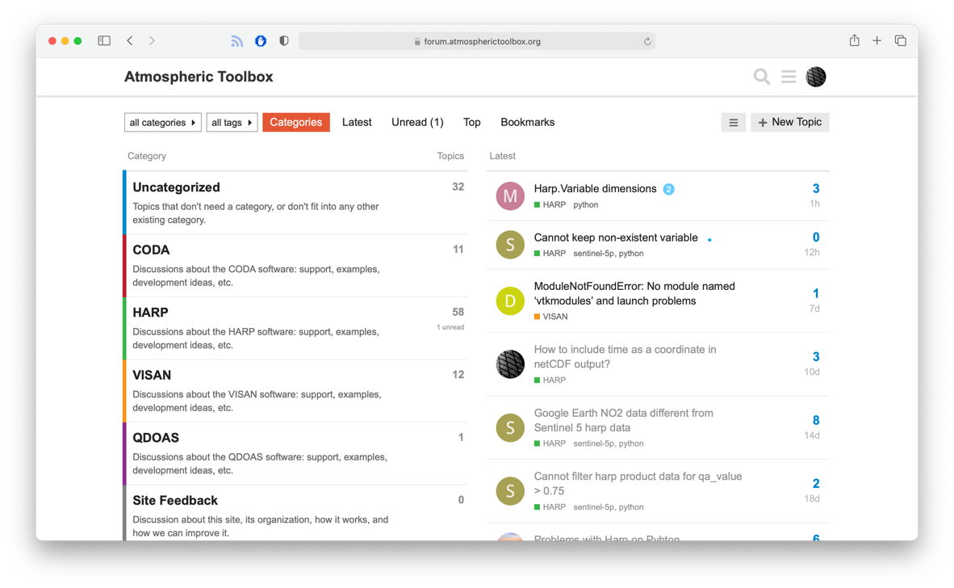
Atmosphere Virtual Lab
New harp 1.19 release later this week
https://forum.atmospherictoolbox.org

